Slide 1

Unit-1
Android Programming
Introduction
KLE Society’s College of BCA RLSI Belagavi

Slide 2
Mobile Communication is the use of technology that allows us to communicate with others in different locations without the use of any physical connection (wires or cables).
Basic components of Mobile communication
Phone
public switched telephone network (PSTN)
made up of local networks
mobile telephone switching office (MTSO)
MTSO is the central office for mobile switching
KLE Society’s College of BCA RLSI Belagavi

Slide 3
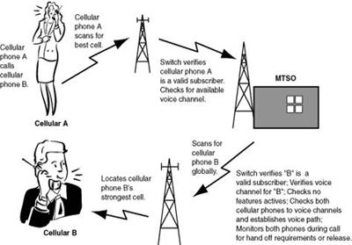
How mobile communication works
KLE Society’s College of BCA RLSI Belagavi

Slide 4
Advantages of Mobile Communication
Flexibility
Cost effectiveness
Speed
Accessibility
Constant connectivity
KLE Society’s College of BCA RLSI Belagavi

Slide 5
Mobile Computing
Mobile Computing refers a technology that allows transmission of data, voice and video via a computer or any other wireless enabled device.
The concept of Mobile Computing can be divided into three parts:
Mobile Communication
Mobile Hardware
Mobile Software
mobile communication refers to an infrastructure that ensures seamless and reliable communication among wireless devices.
KLE Society’s College of BCA RLSI Belagavi

Slide 6
Mobile communication can be divided in the following four types:
Fixed and Wired
Fixed and Wireless
Mobile and Wired
Mobile and Wireless
KLE Society’s College of BCA RLSI Belagavi

Slide 7
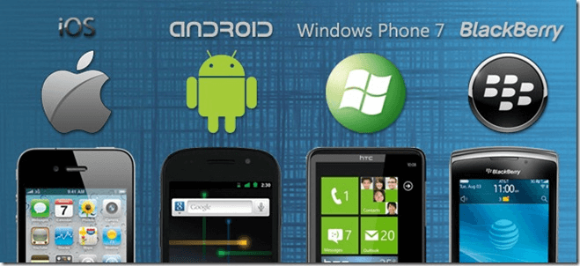
Mobile hardware consists of mobile devices or device components that can be used to receive or access the service of mobility. Examples of mobile hardware can be smart phones, laptops, portable PCs, tablet PCs, Personal Digital Assistants, etc.
Mobile software is a program that runs on mobile hardware
This is the operating system for the appliance of mobile devices. In other words, you can say it the heart of the mobile systems
KLE Society’s College of BCA RLSI Belagavi

Slide 8
What is Android?
Android is an open source and Linux-based Operating System for mobile devices such as smart phones and tablet computers.
History
Initially, Andy Rubin founded Android Incorporation in Palo Alto, California, United States in October, 2003.
In 17th August 2005, Google acquired android Incorporation. Since then, it is in the subsidiary of Google Incorporation.
The key employees of Android Incorporation are Andy Rubin, Rich Miner, Chris White and Nick Sears.
Android is the nick name of Andy Rubin given by co-workers when he was working at Apple, because of his love to robots.
KLE Society’s College of BCA RLSI Belagavi

Slide 9
In 2007, Google announces the development of android OS.
Later the development taken under OHA (Open Handset Alliance).
What is Open Handset Alliance (OHA)
It's a consortium of 84 companies such as google, samsung, AKM, synaptics, KDDI, Garmin, Teleca, Ebay, Intel etc.
It was established on 5th November, 2007, led by Google. It is committed to advance open standards, provide services and deploy handsets using the Android Platform.
Android 1.0 (API 1) was launched on the 23rd Of September 2008. It was incorporated into the HTC Dream smartphone (aka T-mobile G1 in the US).
KLE Society’s College of BCA RLSI Belagavi

Slide 10
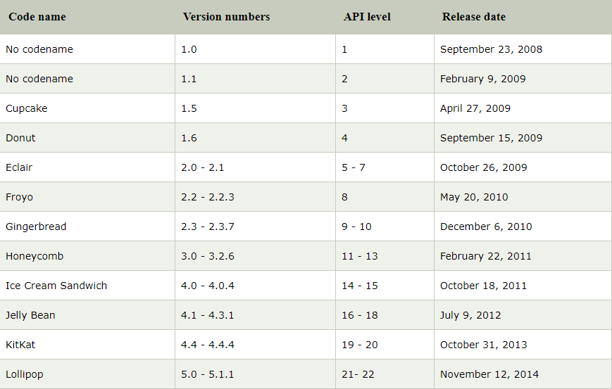
Android Versions
KLE Society’s College of BCA RLSI Belagavi

Slide 11
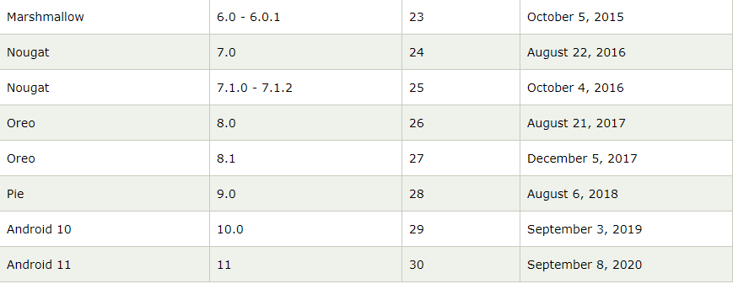
KLE Society’s College of BCA RLSI Belagavi

Slide 12
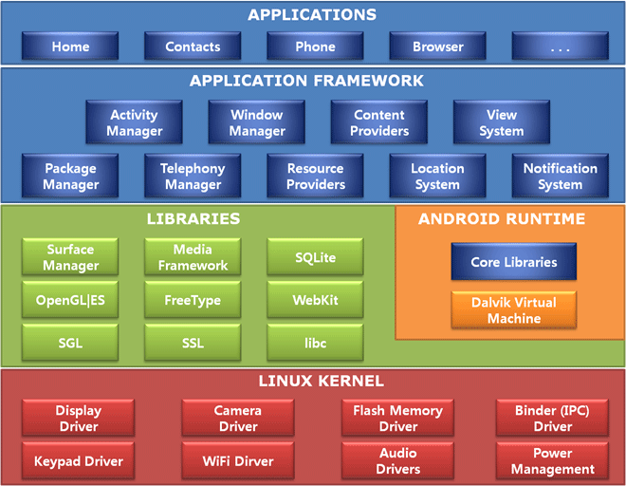
Android Architecture
KLE Society’s College of BCA RLSI Belagavi

Slide 13
Android Architecture
android architecture or Android software stack is categorized into five parts:
linux kernel
native libraries (middleware),
Android Runtime
Application Framework
Applications
KLE Society’s College of BCA RLSI Belagavi

Slide 14
Linux kernel
It is the heart of android architecture that exists at the root of android architecture. Linux kernel is responsible for device drivers, power management, memory management, device management and resource access.
Native Libraries
On the top of linux kernel, their are Native libraries such as WebKit, OpenGL, FreeType, SQLite, Media, C runtime library (libc) etc.
The surface manager library is responsible for rendering windows and drawing surfaces of various apps on the screen.
The WebKit library is responsible for browser support
SQLite is for database,
FreeType for font support,
Media for playing and recording audio and video formats.
SGL: 2D Graphics
Open GL|ES: 3D Library
SSL(Secure Sockets Layer) libraries responsible for Internet security
C runtime library (libc)
KLE Society’s College of BCA RLSI Belagavi

Slide 15
Android Runtime
In android runtime, there are core libraries and DVM (Dalvik Virtual Machine) which is responsible to run android application. DVM is like JVM but it is optimized for mobile devices. It consumes less memory and provides fast performance.
Android Libraries
This category encompasses those Java-based libraries that are specific to Android development. Examples of libraries in this category include the application framework libraries in addition to those that facilitate user interface building, graphics drawing and database access.
KLE Society’s College of BCA RLSI Belagavi

Slide 16
Application Framework
The Application Framework layer provides many higher-level services to applications in the form of Java classes. Application developers are allowed to make use of these services in their applications.
The Android framework includes the following key services −
Activity Manager − Controls all aspects of the application lifecycle and activity stack.
window manager is responsible for organizing the screen, applications don't get to decide that
Content Providers − Allows applications to publish and share data with other applications.
Resource Manager − Provides access to non-code embedded resources such as strings, color settings and user interface layouts.
Notifications Manager − Allows applications to display alerts and notifications to the user.
View System − An extensible set of views used to create application user interfaces.
Package Manager: Manages various kinds of information related to the application packages that are currently installed on the device.
Telephony Manager: Enables app to use phone capabilities of the device.
LocationManager – This class helps to get access to the location service of the system
KLE Society’s College of BCA RLSI Belagavi

Slide 17
Application Layer
The applications are at the topmost layer of the Android stack. An average user of the Android device would mostly interact with this layer (for basic functions, such as making phone calls, accessing the Web browser etc.). The layers further down are accessed mostly by developers, programmers and the likes.
Several standard applications come installed with every device, such as:
SMS client app
Dialer
Web browser
Contact manager
KLE Society’s College of BCA RLSI Belagavi

Slide 18
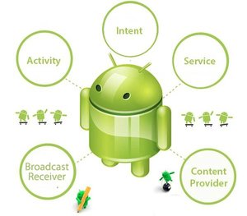
Android Core Building Blocks
The core building blocks or fundamental components of android are activities, views, intents, services, content providers, fragments and AndroidManifest.xml.
KLE Society’s College of BCA RLSI Belagavi

Slide 19
Activities
An activity is the entry point for interacting with the user. It represents a single screen with a user interface. For example, an email app might have one activity that shows a list of new emails, another activity to compose an email, and another activity for reading emails.
Activity is the subclass of the ContextThemeWrapper class. An Activity starting with onCreate() callback method
We should declare our activity inside the AndroidManifest.xml file or else it going to show run time error.
The declaration will be like:
View
A view is the UI element such as button, label, text field etc. Anything that you see is a view.
KLE Society’s College of BCA RLSI Belagavi

Slide 20
Intent
It is used to invoke components, like
Start a new service
Display an another activity
Display a webpage
Display a message etc.
The intent has two types:
Explicit Intent: Explicit Intent is used only for the internal purpose like to start another activity or send data between two activities.
Implicit Intent: Implicit Intent is used to connect with the outer side of the application, like to make a call, sending mail, phone, see any web sites, etc
KLE Society’s College of BCA RLSI Belagavi

Slide 21
Services A service is a general-purpose entry point for keeping an app running in the background for all kinds of reasons.
A service does not provide a user interface. For example, a service might play music in the background while the user is in a different app, or it might fetch data over the network without blocking user interaction with an activity.
Background services
Background services do not require any user intervention. These services do not notify the user about ongoing background tasks and users also cannot access them. The process like schedule syncing of data or storing of data fall under this service.
Bound services
Bound services run because some other app (or the system) has said that it wants to make use of the service. This is basically the service providing an API to another process.
The system thus knows there is a dependency between these processes, so if process A is bound to a service in process B, it knows that it needs to keep process B (and its service) running for A.
KLE Society’s College of BCA RLSI Belagavi

Slide 22
Content Provider
It is used to share content or data between the applications on request. These requests are handled by the ContentResolver. Content Provider stores the data in different ways and stores it in a database, files, or over a network.
Content Provider is similar as database, where we can query data, edit data delete and add data using query(), insert(), update(), and delete() methods. Generally, it used the SQLite database to store data.
KLE Society’s College of BCA RLSI Belagavi

Slide 23
Broadcast Receiver
Broadcast Receivers simply respond to broadcast messages from other applications or from the system itself. These messages are sometime called events or intents. For example, applications can also initiate broadcasts to let other applications know that some data has been downloaded to the device and is available for them to use
Broadcast in android is the system-wide events that can occur when the device starts, when a message is received on the device or when incoming calls are received, or when a device goes to an airplane mode, etc.
Broadcast Receivers are used to respond to these system-wide events. Broadcast Receivers allow us to register for the system and application events, and when that event happens, then the register receivers get notified.
Indicates low battery condition on the device.
This is broadcast once after the system has finished booting
Indicates that the device has been a reboot
The mobile network or wifi connection is changed(or reset)
KLE Society’s College of BCA RLSI Belagavi

Slide 24
Android Installation
System Requirements
Microsoft® Windows® 7/8/10 (64-bit)
4 GB RAM minimum, 8 GB RAM recommended
2 GB of available disk space minimum, 4 GB Recommended (500 MB for IDE + 1.5 GB for Android SDK and emulator system image)
1280 x 800 minimum screen resolution
Link to download Android Software:
https://developer.android.com/studio
KLE Society’s College of BCA RLSI Belagavi

Slide 25
Android SDK
What is the Android SDK?
Android SDK is a collection of libraries and Software Development tools that are essential for Developing Android Applications.
Every time Google releases a new version, the corresponding SDK is also released. In order to work with Android, the developers must download and install each version’s SDK for the particular device.
Components of Android SDK
Android SDK Components play a major role in the Development of Android applications. Below are the important components:
Android SDK Tools
Android SDK Build-Tools
Android Emulator
Android SDK Platform-tools
SDK Platforms
SDK Update Sites
KLE Society’s College of BCA RLSI Belagavi

Slide 26
Android SDK Tools
Android SDK tool is an important component of Android SDK. It consists of a complete set of development and debugging tools. Below are the SDK developer tools:
Android SDK Build tool.
Android Emulator.
Android SDK Platform-tools.
2. Android SDK Build-Tools
Android SDK build tools are used for building actual binaries of Android App. The main functions of Android SDK Build tools are built, debug, run and test Android applications.
The latest version of the Android SDK Build tool is 30.0.3. While downloading or updating Android in our System, one must ensure that its latest version is download in SDK Components.
KLE Society’s College of BCA RLSI Belagavi

Slide 27
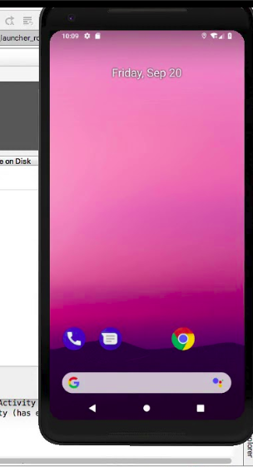
3. Android Emulator
An Android Emulator is a device that simulates an Android device on your system. Suppose we want to run our android application that we code.
One option is that we will run this on our Android Mobile by Enabling USB Debugging on our mobile. Another option is using Android Emulator.
In Android Emulator the virtual android device is shown on our system on which we run the Android application that we code
KLE Society’s College of BCA RLSI Belagavi

Slide 28
SDK Platform-Tools
Android Platform-Tools are used to support the features for the current Android platform and are necessary for Android app development. These tools interface with the Android platform on the device you use for testing.
Android Debug Bridge (adb): This is a handy command-line tool that lets you communicate with a device.
fastboot: This lets you flash a device with a new system image.
KLE Society’s College of BCA RLSI Belagavi

Slide 29
SDK Platforms
For Each Android Software, one SDK platform is available as shown below
These are numbered according to the android version. The new version of the SDK platform has more features and more compatible but the old version is less compatible with fewer features
KLE Society’s College of BCA RLSI Belagavi

Slide 30
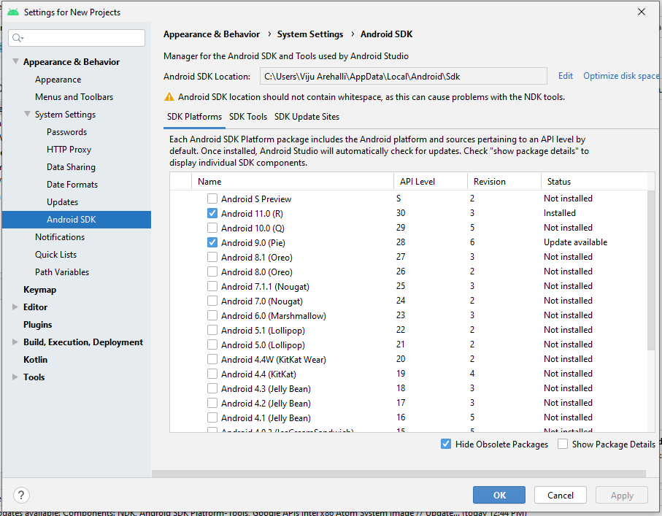
Android SDK
Android SDK is a software development kit developed by Google for the Android platform.
KLE Society’s College of BCA RLSI Belagavi

Slide 31
The Android SDK is a collection of software development tools and libraries required to develop Android applications.
Every time Google releases a new version of Android or an update, a corresponding SDK is also released which developers must download and install.
How to Install the Android SDK
To install the Android SDK from within Android Studio, first start Android Studio.
From the Android Studio start page, select Tools > SDK Manager.
Select Android version and click on ok, u can also install required SDK tools in SDK tools tab
KLE Society’s College of BCA RLSI Belagavi

Slide 32
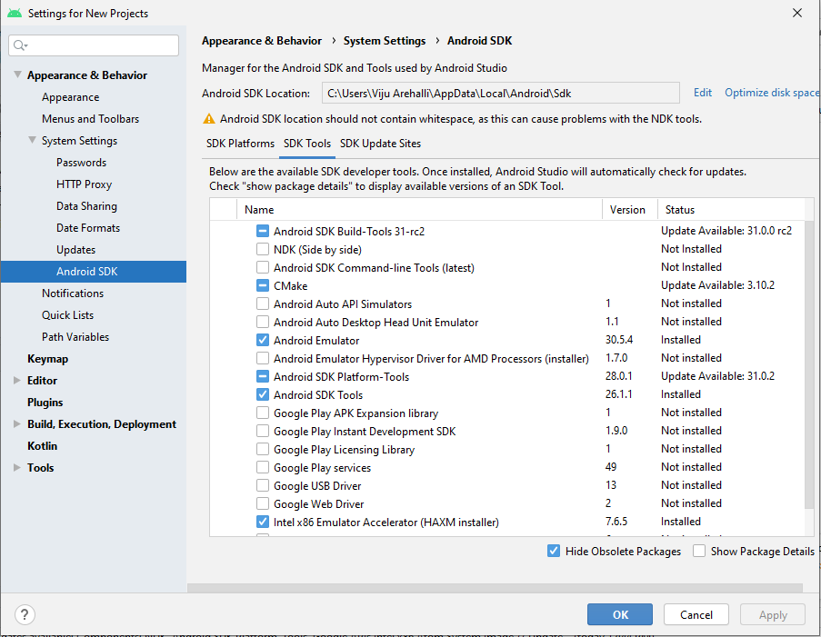
KLE Society’s College of BCA RLSI Belagavi

Slide 33
NDK(Native Development Kit)
The Native Development Kit (NDK) is a set of tools that allows you to use C and C++ code with Android, and provides platform libraries you can use to manage native activities and access physical device components, such as sensors and touch input.
The NDK can be useful for cases in which you need to do one or more of the following:
Squeeze extra performance out of a device to achieve low latency or run computationally intensive applications, such as games or physics simulations.
Reuse your own or other developers' C or C++ libraries.
KLE Society’s College of BCA RLSI Belagavi

Slide 34
Android Emulator (Android Virtual Device) (AVD)
The Android Emulator simulates Android devices on your computer so that you can test your application on a variety of devices and Android API levels without needing to have each physical device.
The emulator provides almost all of the capabilities of a real Android device. You can simulate incoming phone calls and text messages, specify the location of the device, simulate rotation and other hardware sensors, access the Google Play Store, and much more
Testing your app on the emulator is in some ways faster and easier than doing so on a physical device. For example, you can transfer data faster to the emulator than to a device connected over USB.
KLE Society’s College of BCA RLSI Belagavi

Slide 35
The Android Emulator has additional requirements beyond the basic system requirements for Android Studio, which are described below:
SDK Tools 26.1.1 or higher
64-bit processor
HAXM 6.2.1 or later
HAXM stands for "Hardware Accelerated Execution Manager". It is used for launching Emulators.
(before installing HAXM, check Whether virtualization is enabled or not)
KLE Society’s College of BCA RLSI Belagavi

Slide 36
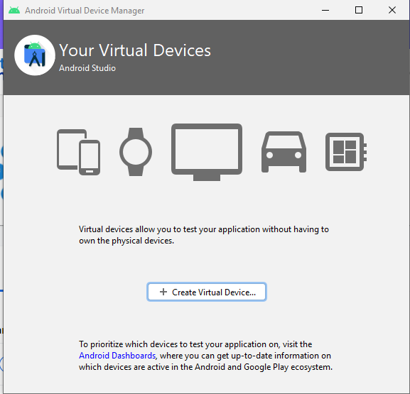
Installing Android Emulator
From the Android Studio start page, select Tools > ADK Manager.
Click on create virtual device button
KLE Society’s College of BCA RLSI Belagavi

Slide 37
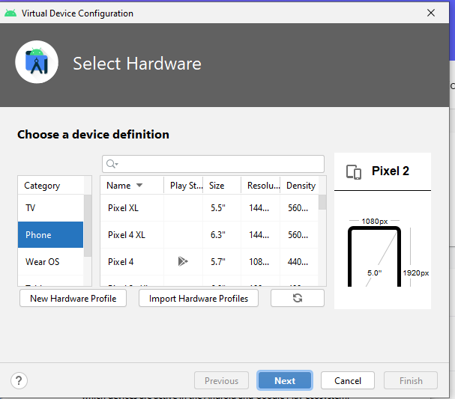
Select hardware as phone or other device and select e emulator name based on your requirement.
KLE Society’s College of BCA RLSI Belagavi

Slide 38
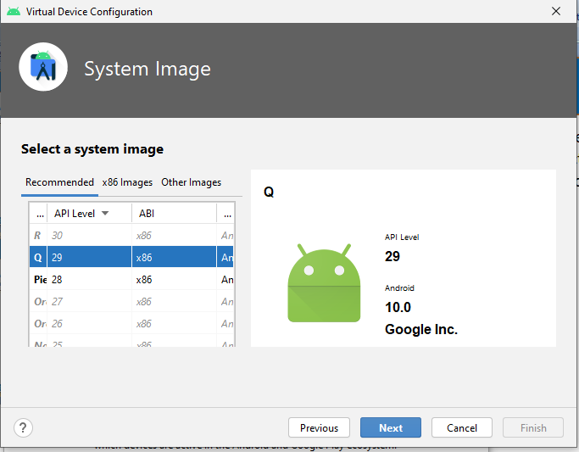
Select system image(android version)
Next verify the configuration and click finish.
KLE Society’s College of BCA RLSI Belagavi

Slide 39
Dalvik Virtual Machine / DVM Dalvik Virtual Machine / DVM
As we know the modern JVM is high performance and provides excellent memory management. But it needs to be optimized for low-powered handheld devices as well.
The Dalvik Virtual Machine (DVM) is an android virtual machine optimized for mobile devices. It optimizes the virtual machine for memory, battery life and performance.
Dalvik is a name of a town in Iceland. The Dalvik VM was written by Dan Bornstein.
The Dex compiler converts the class files into the .dex file that run on the Dalvik VM. Multiple class files are converted into one dex file.
KLE Society’s College of BCA RLSI Belagavi

Slide 40
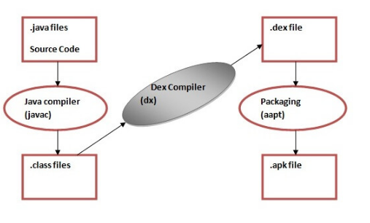
KLE Society’s College of BCA RLSI Belagavi

Slide 41
The javac tool compiles the java source file into the class file.
The dx tool takes all the class files of your application and generates a single .dex file. It is a platform-specific tool.
The Android Assets Packaging Tool (aapt) handles the packaging process.
KLE Society’s College of BCA RLSI Belagavi

Slide 42
AndroidManifest.xml file in android AndroidManifest.xml file in android
The AndroidManifest.xml file contains information of your package, including components of the application such as activities, services, broadcast receivers, content providers etc.
It performs some other tasks also:
It is responsible to protect the application to access any protected parts by providing the permissions.
It also declares the android api that the application is going to use.
It lists the instrumentation classes. The instrumentation classes provides profiling and other information's. These information's are removed just before the application is published etc.
KLE Society’s College of BCA RLSI Belagavi

Slide 43
Example:
<?xml version="1.0" encoding="utf-8"?>
<manifest xmlns:android="http://schemas.android.com/apk/res/android"
package="com.example.myapp"
android:versionCode="1"
android:versionName="1.0" >
...
</manifest>
KLE Society’s College of BCA RLSI Belagavi

Slide 44
Android Gradle Android Gradle
Gradle is a build system, which is responsible for code compilation, testing, deployment and conversion of the code into .dex files and hence running the app on the device.
As Android Studio comes with Gradle system pre-installed, there is no need to install additional runtime softwares to build our project.
Whenever you click on Run button in android studio, a gradle task automatically triggers and starts building the project and after gradle completes its task, app starts running in AVD or in the connected device.
KLE Society’s College of BCA RLSI Belagavi

Slide 45
A build system like Gradle is not a compiler, linker etc, but it controls and supervises the operation of compilation, linking of files, running test cases, and eventually bundling the code into an apk file for your Android Application.
There are two build.gradle files for every android studio project of which, one is for application and other is for project level(module level) build files.
KLE Society’s College of BCA RLSI Belagavi

Slide 46
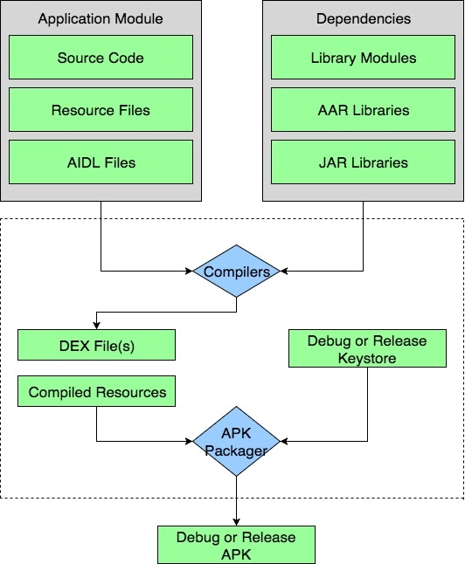
KLE Society’s College of BCA RLSI Belagavi

Slide 47
In the build process, the compiler takes the source code, resources, external libraries JAR files and AndroidManifest.xml(which contains the meta-data about the application) and convert them into .dex(Dalvik Executable files) files, which includes bytecode.
That bytecode is supported by all android devices to run your app. Then APK Manager combines the .dex files and all other resources into single apk file
KLE Society’s College of BCA RLSI Belagavi

Slide 48
Synch in Android
Syncing on your Android device simply means to synchronize your contacts and other information to Google. You should be able to access this by checking out Settings>Accounts and then sync. The sync function on your Android device simply syncs things such as your contacts, documents, and contacts to certain services such as Google, Facebook, and the likes.
The moment the device syncs, it simply means that it is connecting data from your Android device to the server. The good thing about this function is that if you switch phones and the new phone can sync, you will be able to get back your documents and contacts to your phone.
KLE Society’s College of BCA RLSI Belagavi

Slide 49
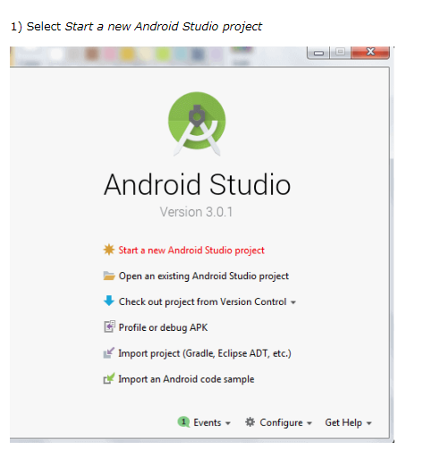
Hello Android Example Hello Android Example
KLE Society’s College of BCA RLSI Belagavi

Slide 50
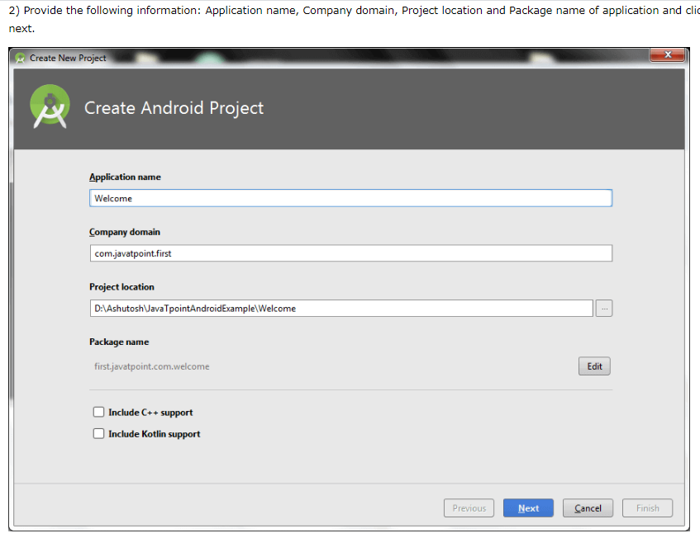
KLE Society’s College of BCA RLSI Belagavi

Slide 51
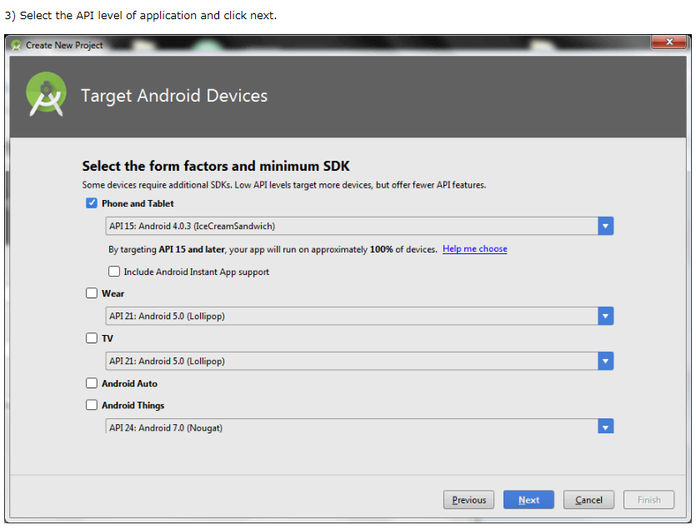
KLE Society’s College of BCA RLSI Belagavi

Slide 52
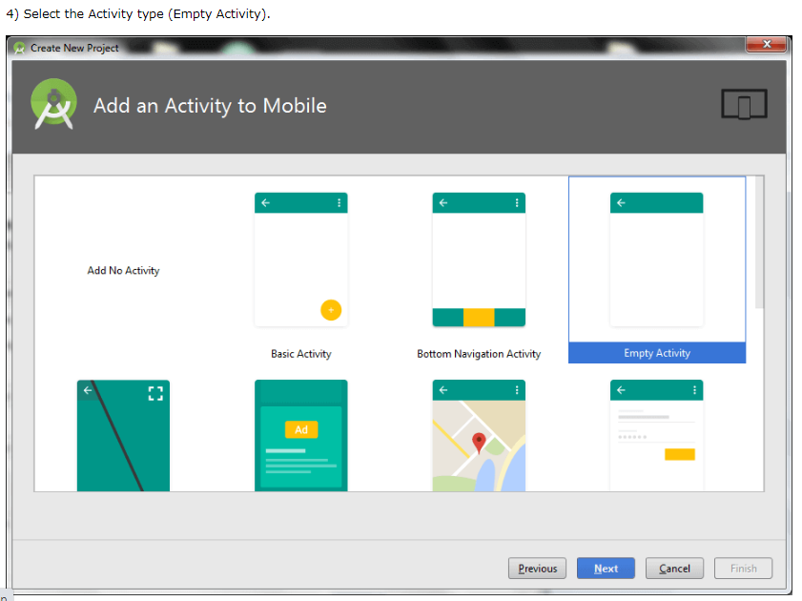
KLE Society’s College of BCA RLSI Belagavi

Slide 53
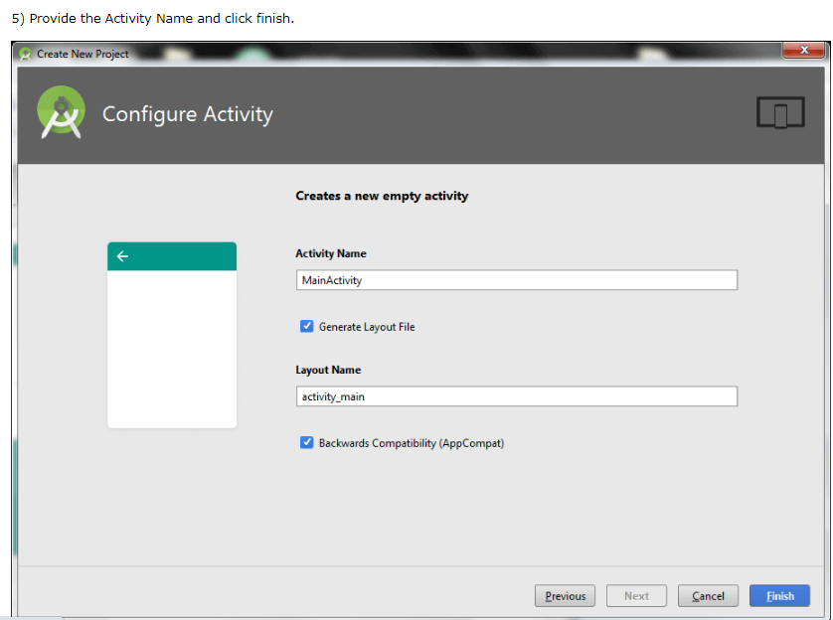
KLE Society’s College of BCA RLSI Belagavi

Slide 54
File: activity_main.xml
Android studio auto generates code for activity_main.xml file. You may edit this file according to your requirement.
<?xml version="1.0" encoding="utf-8"?>
<android.support.constraint.ConstraintLayout xmlns:android="http://schemas.android.com/apk/res/android"
xmlns:app="http://schemas.android.com/apk/res-auto"
xmlns:tools="http://schemas.android.com/tools"
android:layout_width="match_parent"
android:layout_height="match_parent"
tools:context="first.javatpoint.com.welcome.MainActivity">
<TextView
android:layout_width="wrap_content"
android:layout_height="wrap_content"
android:text="Hello Android!"
app:layout_constraintBottom_toBottomOf="parent"
app:layout_constraintLeft_toLeftOf="parent"
app:layout_constraintRight_toRightOf="parent"
app:layout_constraintTop_toTopOf="parent" />
</android.support.constraint.ConstraintLayout>
KLE Society’s College of BCA RLSI Belagavi

Slide 55
File: MainActivity.java
package first.javatpoint.com.welcome;
import android.support.v7.app.AppCompatActivity;
import android.os.Bundle;
public class MainActivity extends AppCompatActivity {
@Override
protected void onCreate(Bundle savedInstanceState) {
super.onCreate(savedInstanceState);
setContentView(R.layout.activity_main);
}
}
KLE Society’s College of BCA RLSI Belagavi

